Slide 1
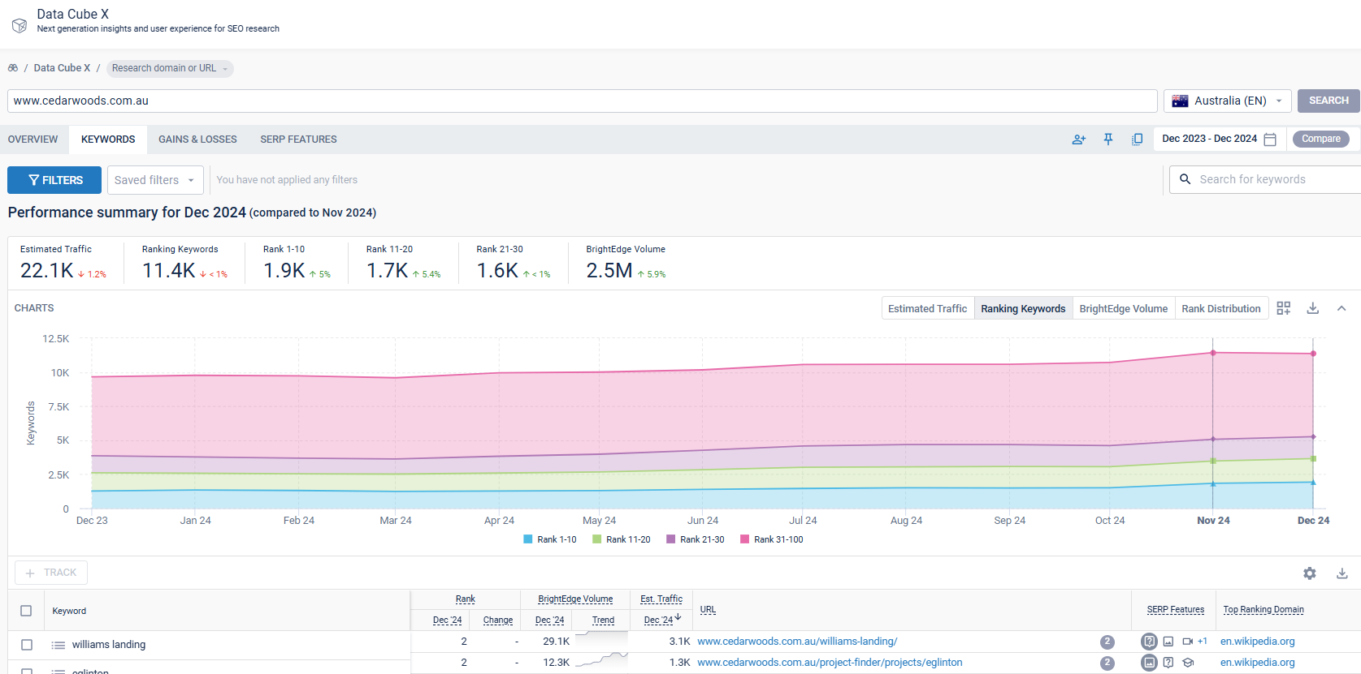
KEYWORD/CONTENT RESEARCH USING DATACUBE
Use Content Research powered by Data Cube X to identify existing content ranking in Google that has the potential to perform better.
Enter a URL from your site or a broad keyword
Click on Keywords to see which keywords are ranking for that URL
Apply Filters to identify terms that are close to performing well:
  Keyword does not contain [branded term]
  Search Volume greater than 99
  Blended Rank worse than 3
  Blended Rank better than 31
Track keywords into keyword groups (by theme) that you want to target for your website

Slide 2
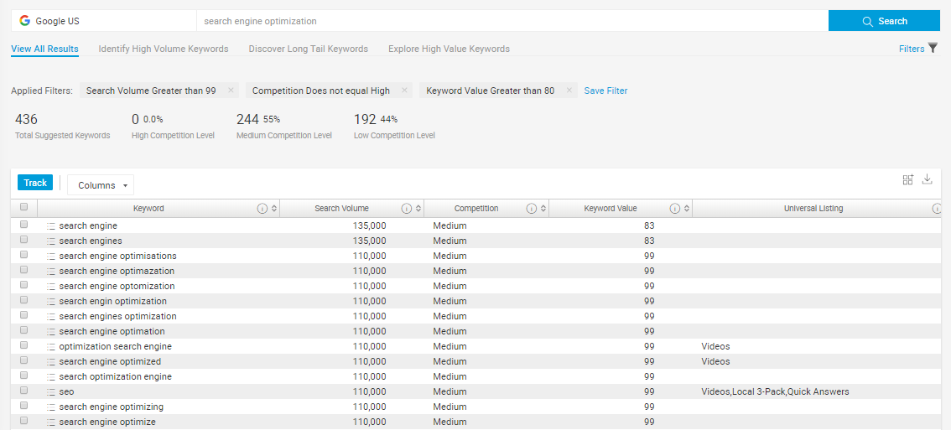
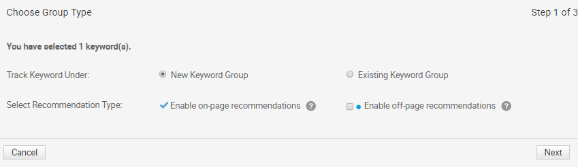
ADD KEYWORDS TO KEYWORD GROUPS
Group keywords from keyword research to easily find and report on them throughout the platform.
1
Click Track
Track Keywords Under
  New Keyword Group
  Existing Keyword Group
Keyword groups are established based on your strategy and segmentation. They help you build reports and recommendations for specific subsets of data to better understand the impact of your site. Keyword groupings that are best for you will depend on the general structure of your SEO strategy.
2

Slide 3
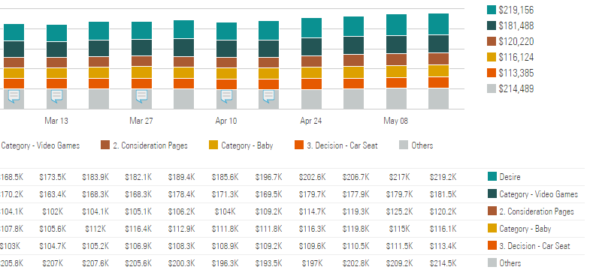
BRIEF INTRODUCTION TO PAGE GROUPS
What are page groups?
Page groups are pages from your domain that you group together in BrightEdge. For example, you may want to group pages that relate to a similar location, service, product, or category.
Why should I group pages?
Page groups help you build reports that show how the group is performing as a whole and in comparison to other groups.
How do I know which page groups to create?
Which page groups are best for you will depend on the general structure of your site and what type of reports (dashboards) you’d like to create.
Using page groups to compare revenue and traffic across different categories / sections of your site

Slide 4
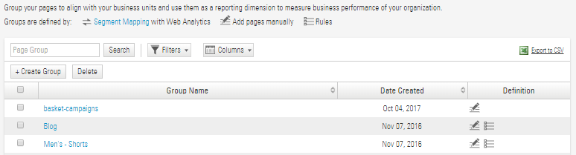
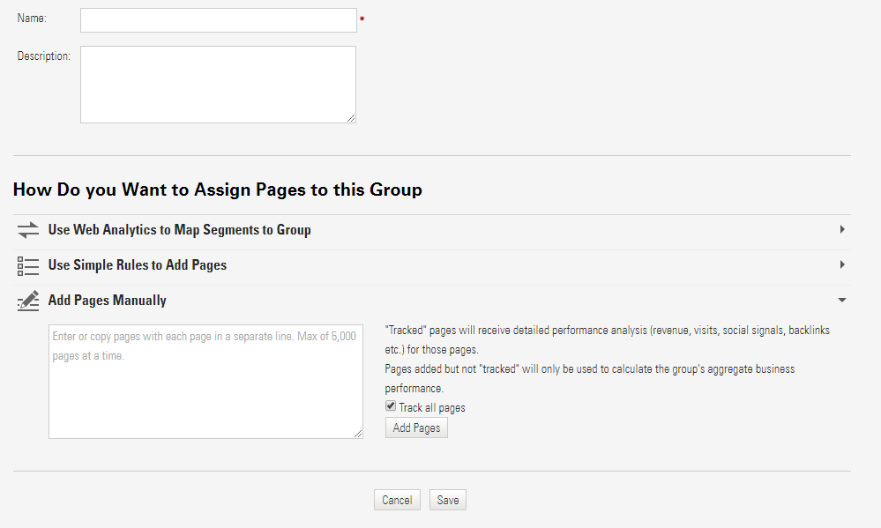
CREATE/EDIT PAGE GROUPS FROM SETTINGS
In Settings → Page Groups…
Click + Create Group
Assign Pages to this Group by
  Using Simple Rules to Add Pages
  Adding Pages Manually
1
2

Slide 5

IDENTIFY THE MOST IMPORTANT KEYWORDS FOR EACH PAGE
SEO Priority
High
KEYWORD 1
KEYWORD 2
KEYWORD 3
KEYWORD 4
KEYWORD …
One Page
Low
Keywords paired with a page
Keyword Priority focus’ Recommendations on your most important keywords

Slide 6
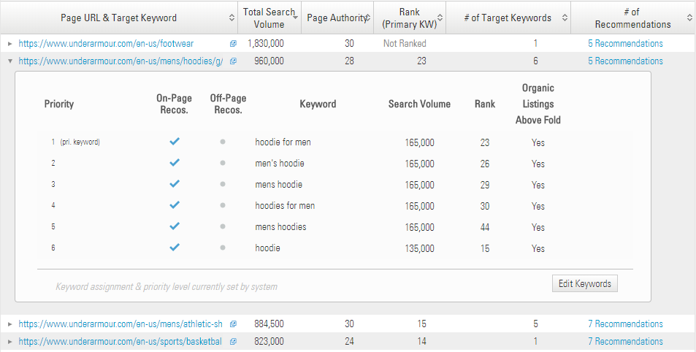
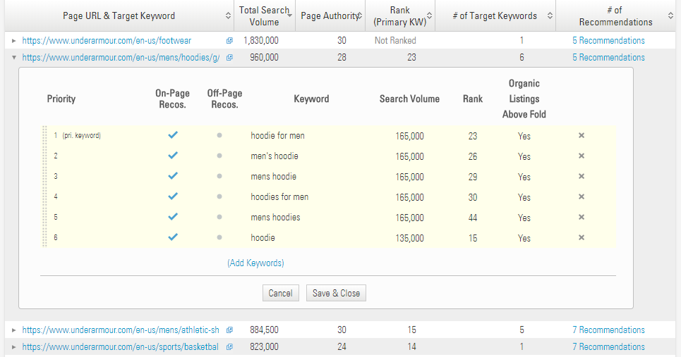
EDITING KEYWORD PRIORITY
In Actions → Recommendations…
Click the arrow to reveal the keywords mapped to the page
Select Edit Keywords
Drag your priority keywords into place considering the following:
  Keyword Intent
  Current Rank
  Search Volume
1
2
3

